Slide 1
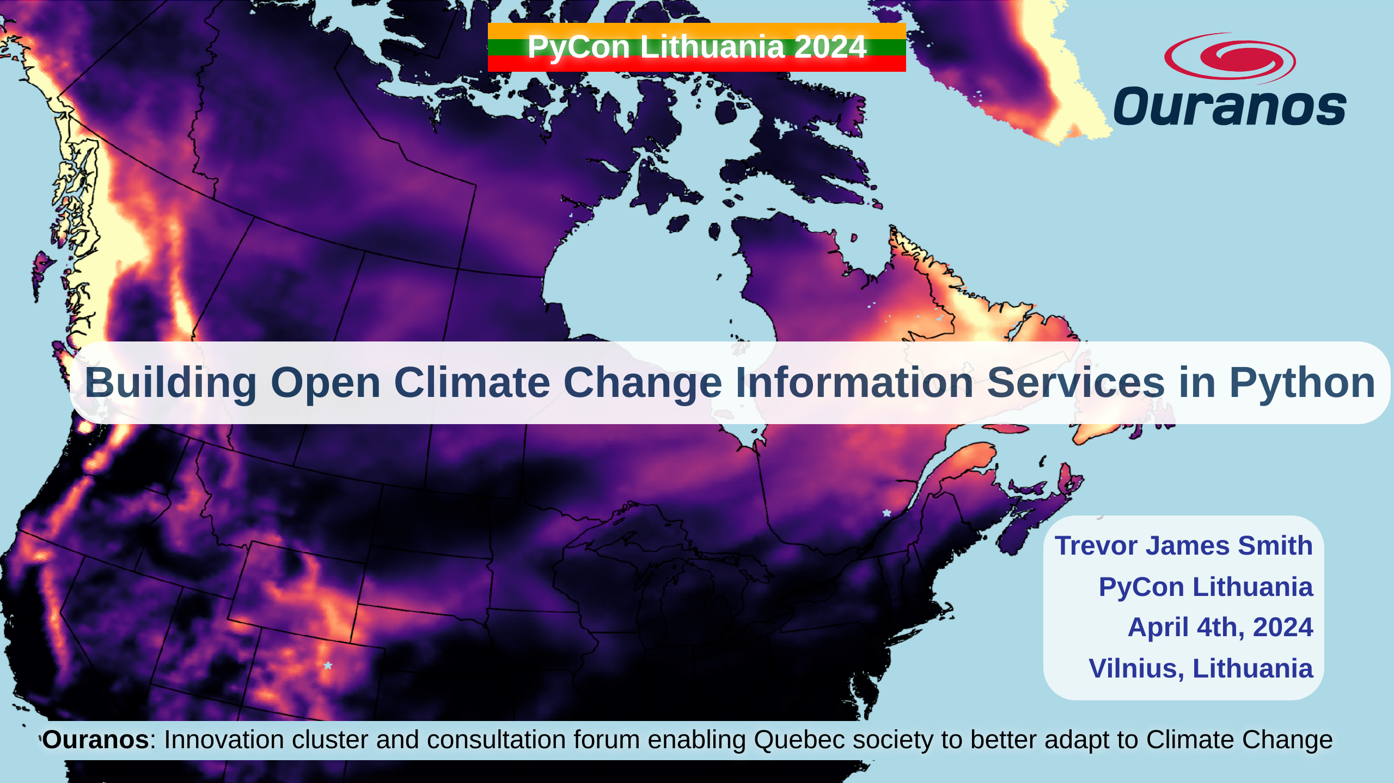
Notes:
Thanks so much to PyCon Lithuania and the organizers for this fantastic conference so far. Today, I’m talking about how we've been using Python to build our open source offerings to better equip researchers interested in climate science.

Slide 2
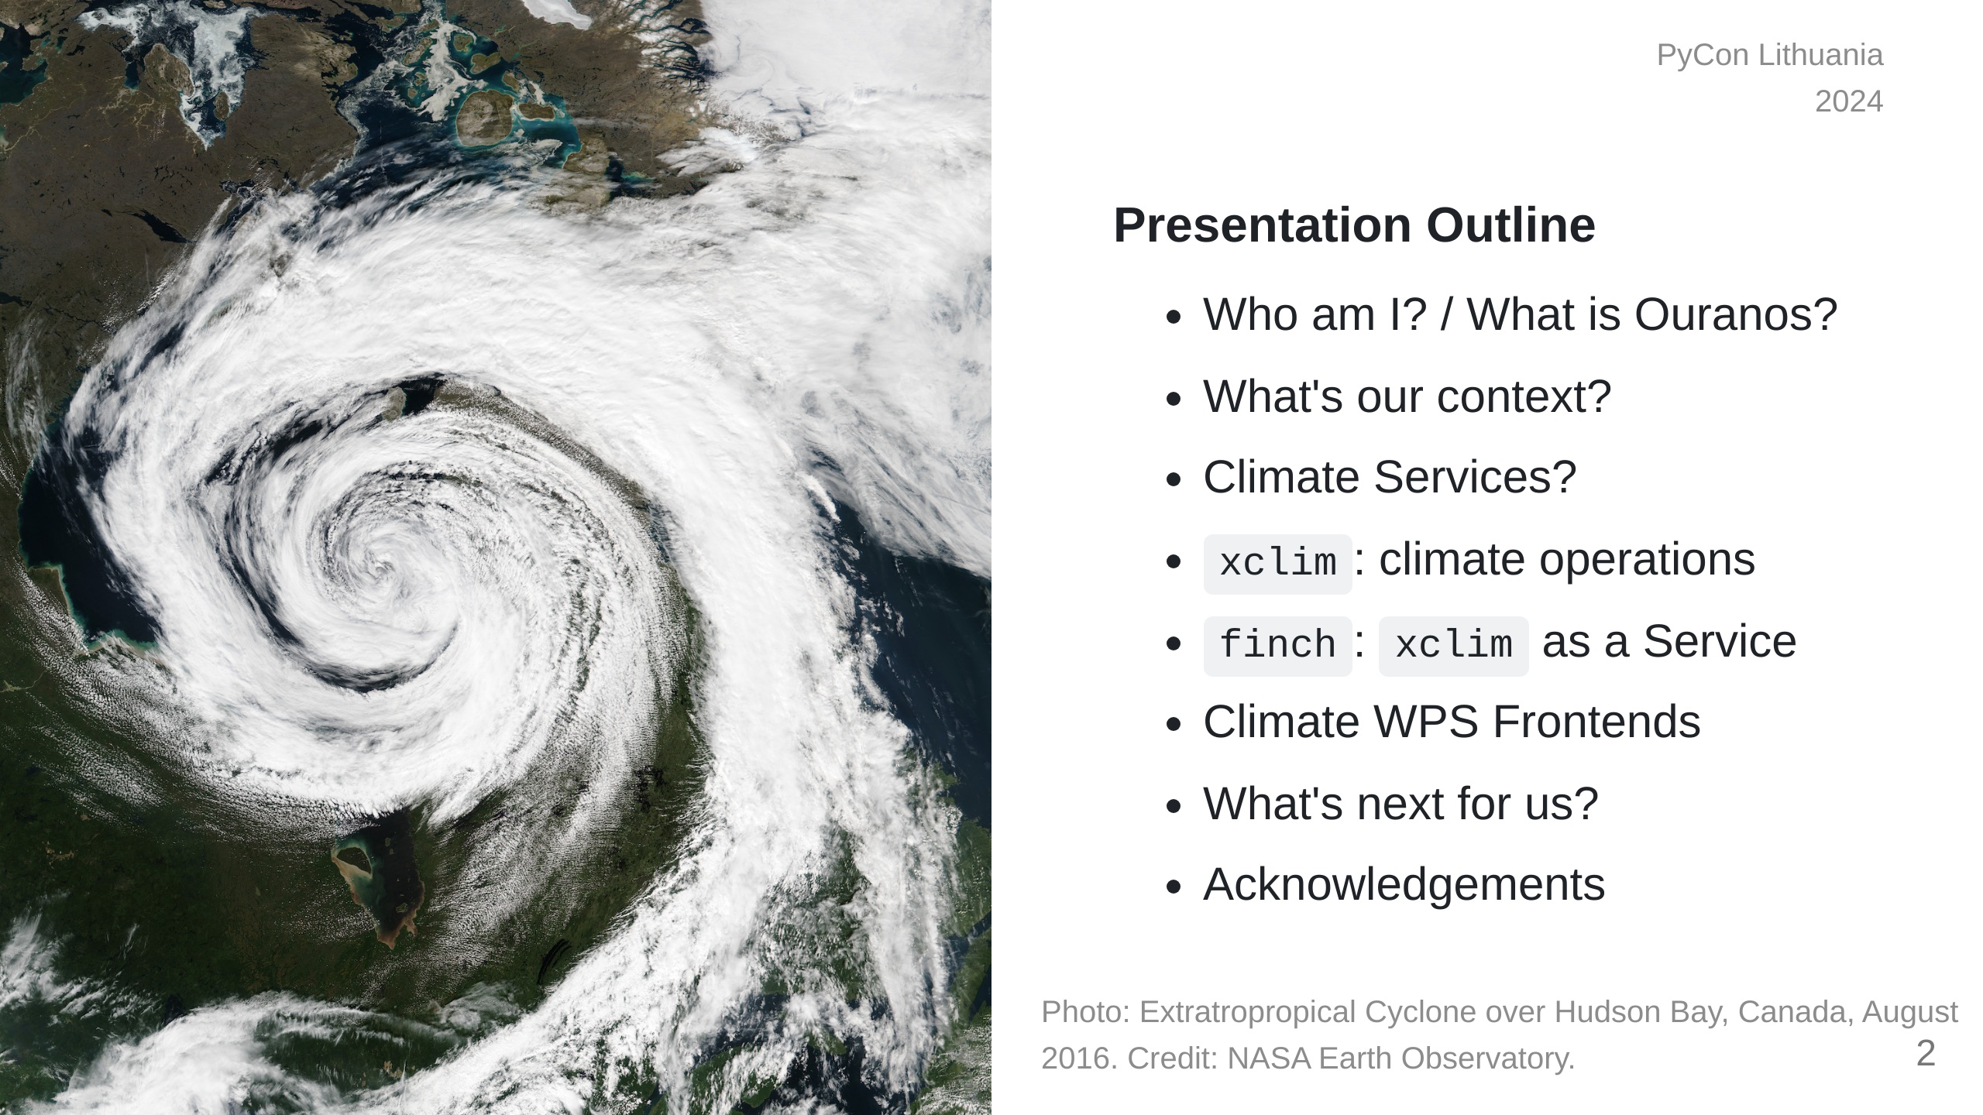
Notes:
This presentation is going to start by providing some context on climate adaptation information services, what my company has built with xclim and how we're actively making these kinds of analyses more accessible worldwide.

Slide 3

Notes:
So who am I? I'm a research software developer from Montréal, Québec. My background is in environmental science, specifically GIS and agroclimate modelling. I only really started picking up dev work on the job. I'm also learning Japanese for fun.

Slide 4
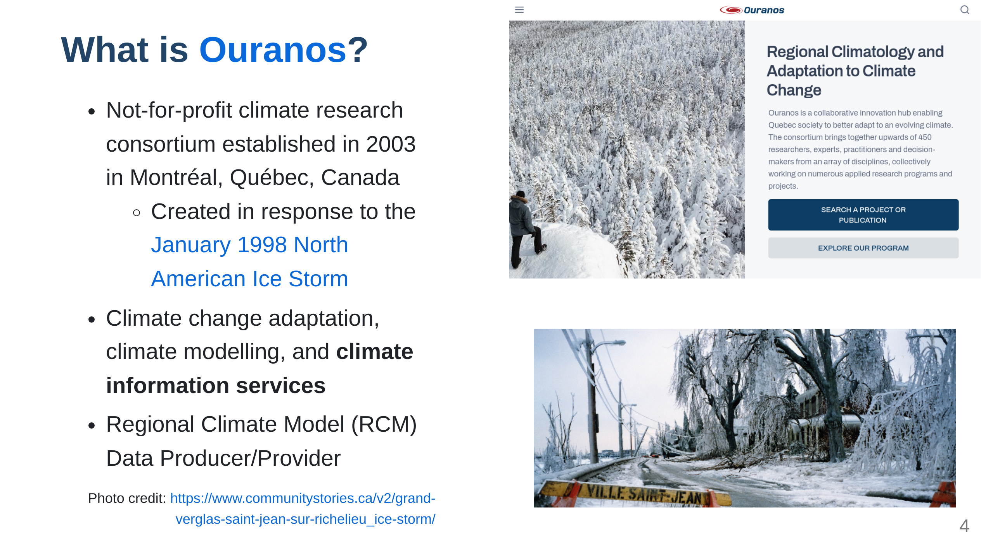
Notes:
My employer, Ouranos, is a not-for-profit based on Montréeal that works with the Canadian and Quebec governments on climate change adaptation. We were created in response to an extreme storm event that had 1.5 Million people without power for weeks and caused around 5.5 Billion dollars in damage. Our role is to connect government, industry, and academia with many types of climate information so that events like those are less impactful. For the past 8 years or so, we've been moving into software and research platform development. The core development team is small, but we do a lot of collaboration.

Slide 5
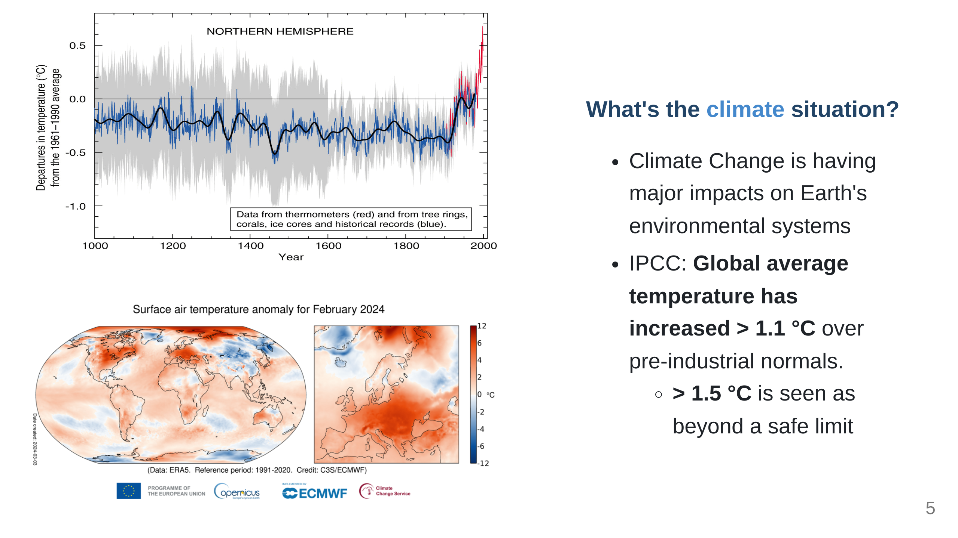
Notes:
Before we get to the Python, it would be good to talk about why climate researchers are becoming software developers; The fact that human-induced Climate Change is occurring is established fact. The temperature change alone has the potential to really impact a lot of things we depend on. Extreme global weather patterns are just one such side effect. *"Since systematic scientific assessments began in the 1970s, the influence of human activities on the warming of the climate system has evolved from theory to established fact"* \- IPCC Sixth Assessment Report Technical Summary (IPCC AR6-TS)

Slide 6
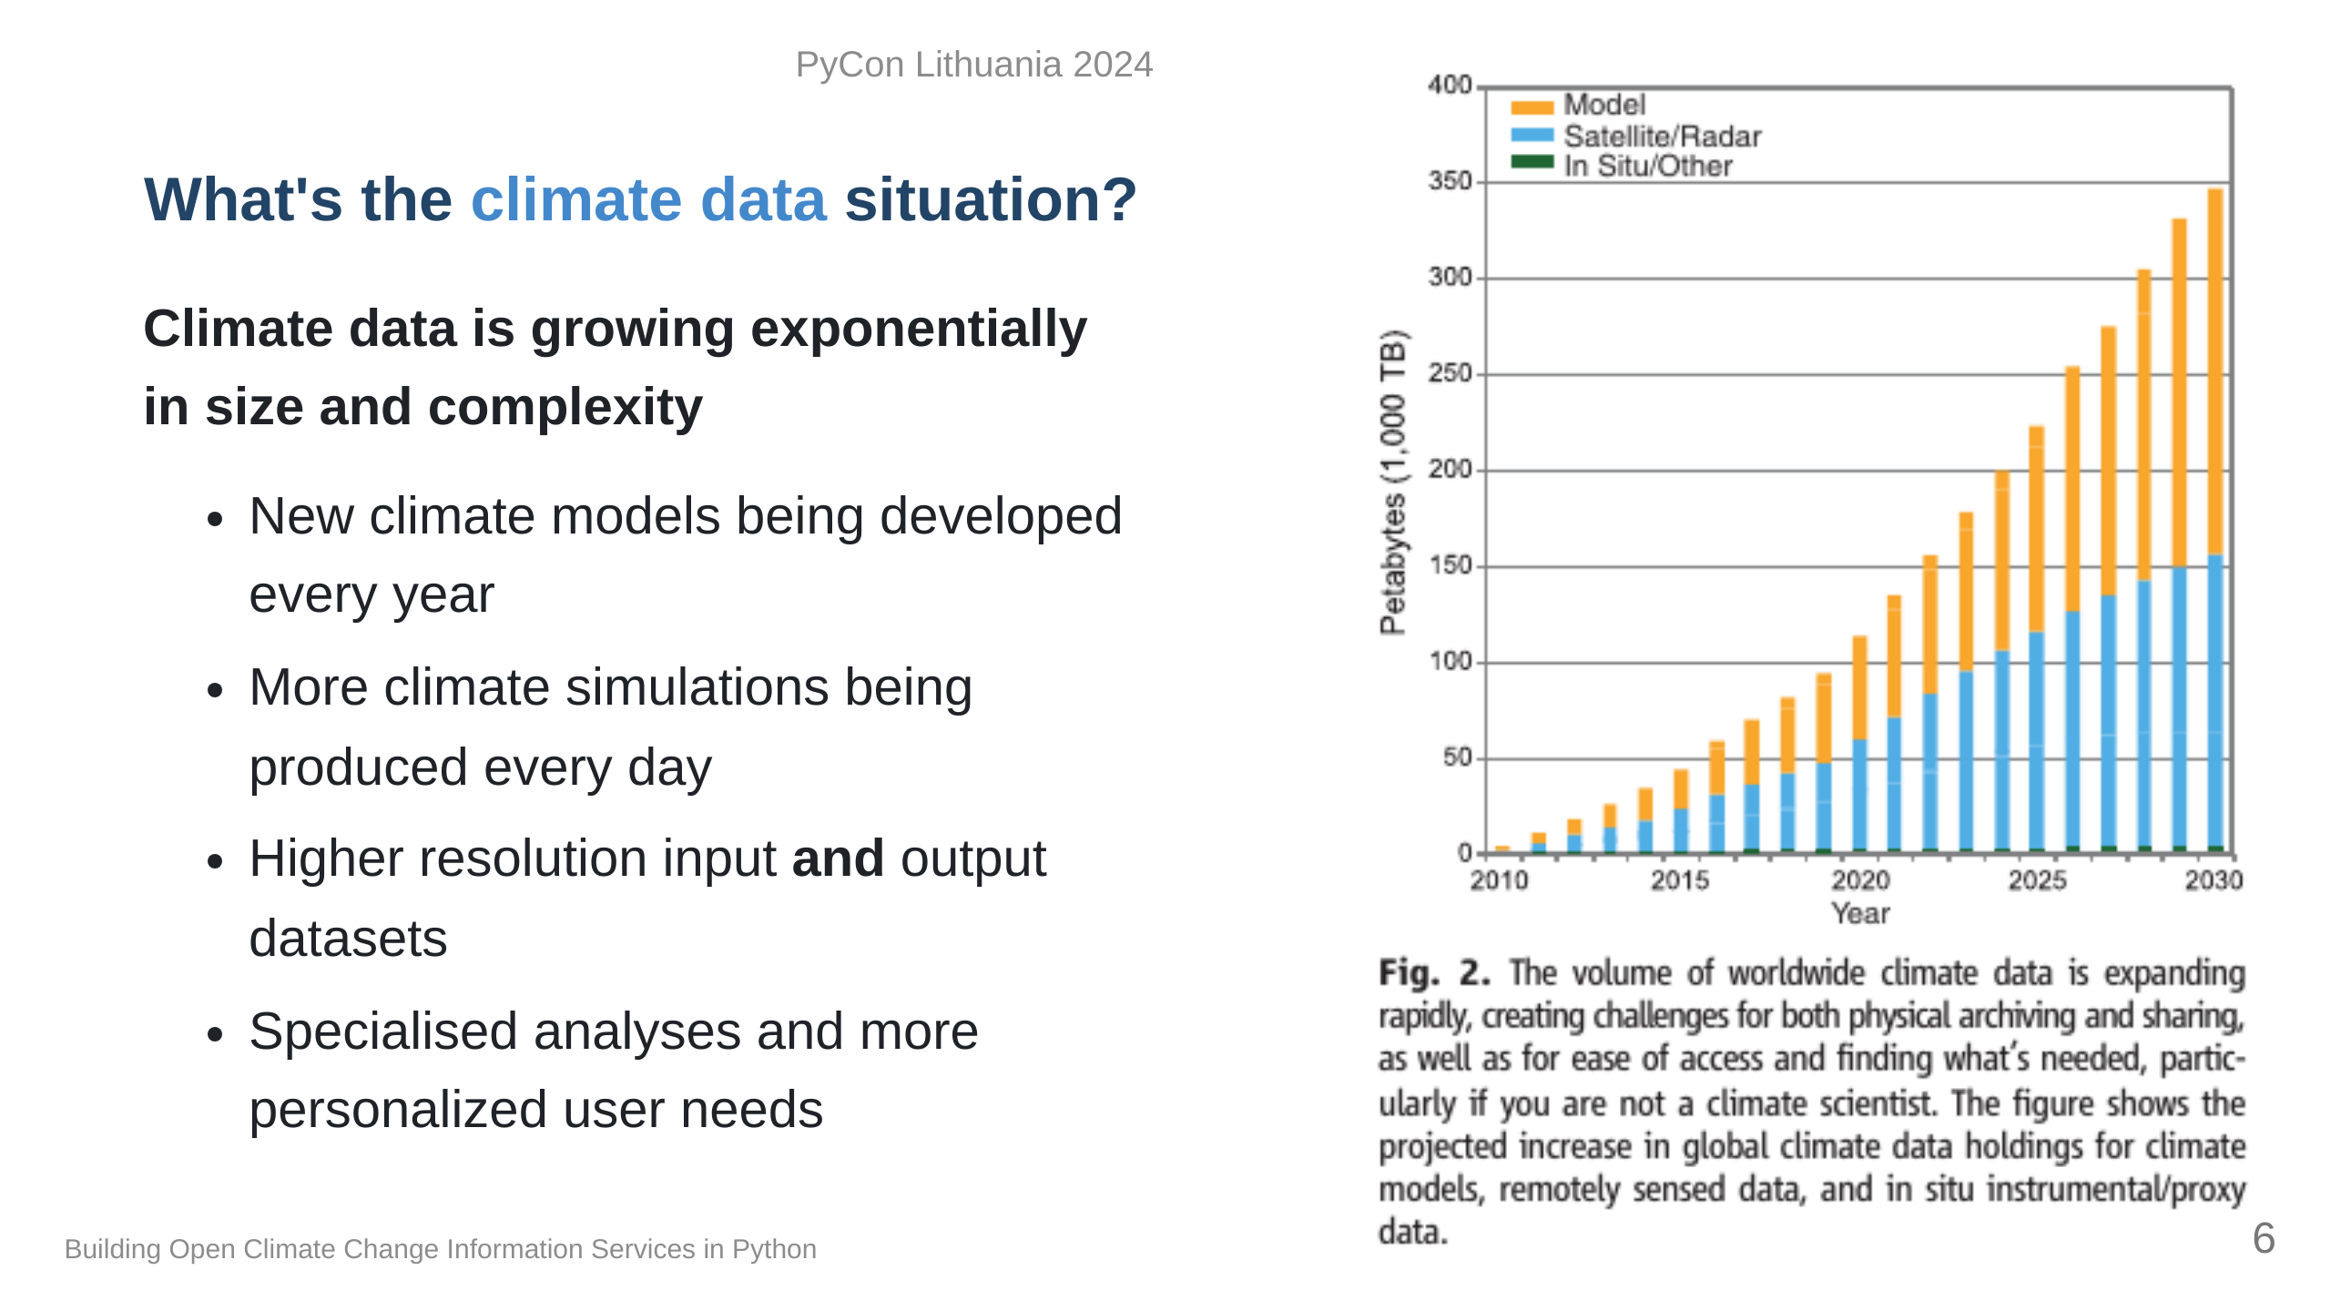
Notes:
Since we only have one Earth to run experiments on, climate models are one tool to give us physically consistent estimates on what the future _could_ look like. Unfortunately, this means we need more and more storage and computation resources to test more hypotheses. At some point it becomes completely unmanageable and really challenging to determine what we want or even use climate data, so we need intermediaries to help. This field is what we call Climate Services. "Overpeck, Jonathan T., Gerald A. Meehl, Sandrine Bony, and David R. Easterling. “Climate Data Challenges in the 21st Century.” Science 331, no. 6018 (February 11, 2011): 700–702. https://doi.org/10.1126/science.1197869"

Slide 7
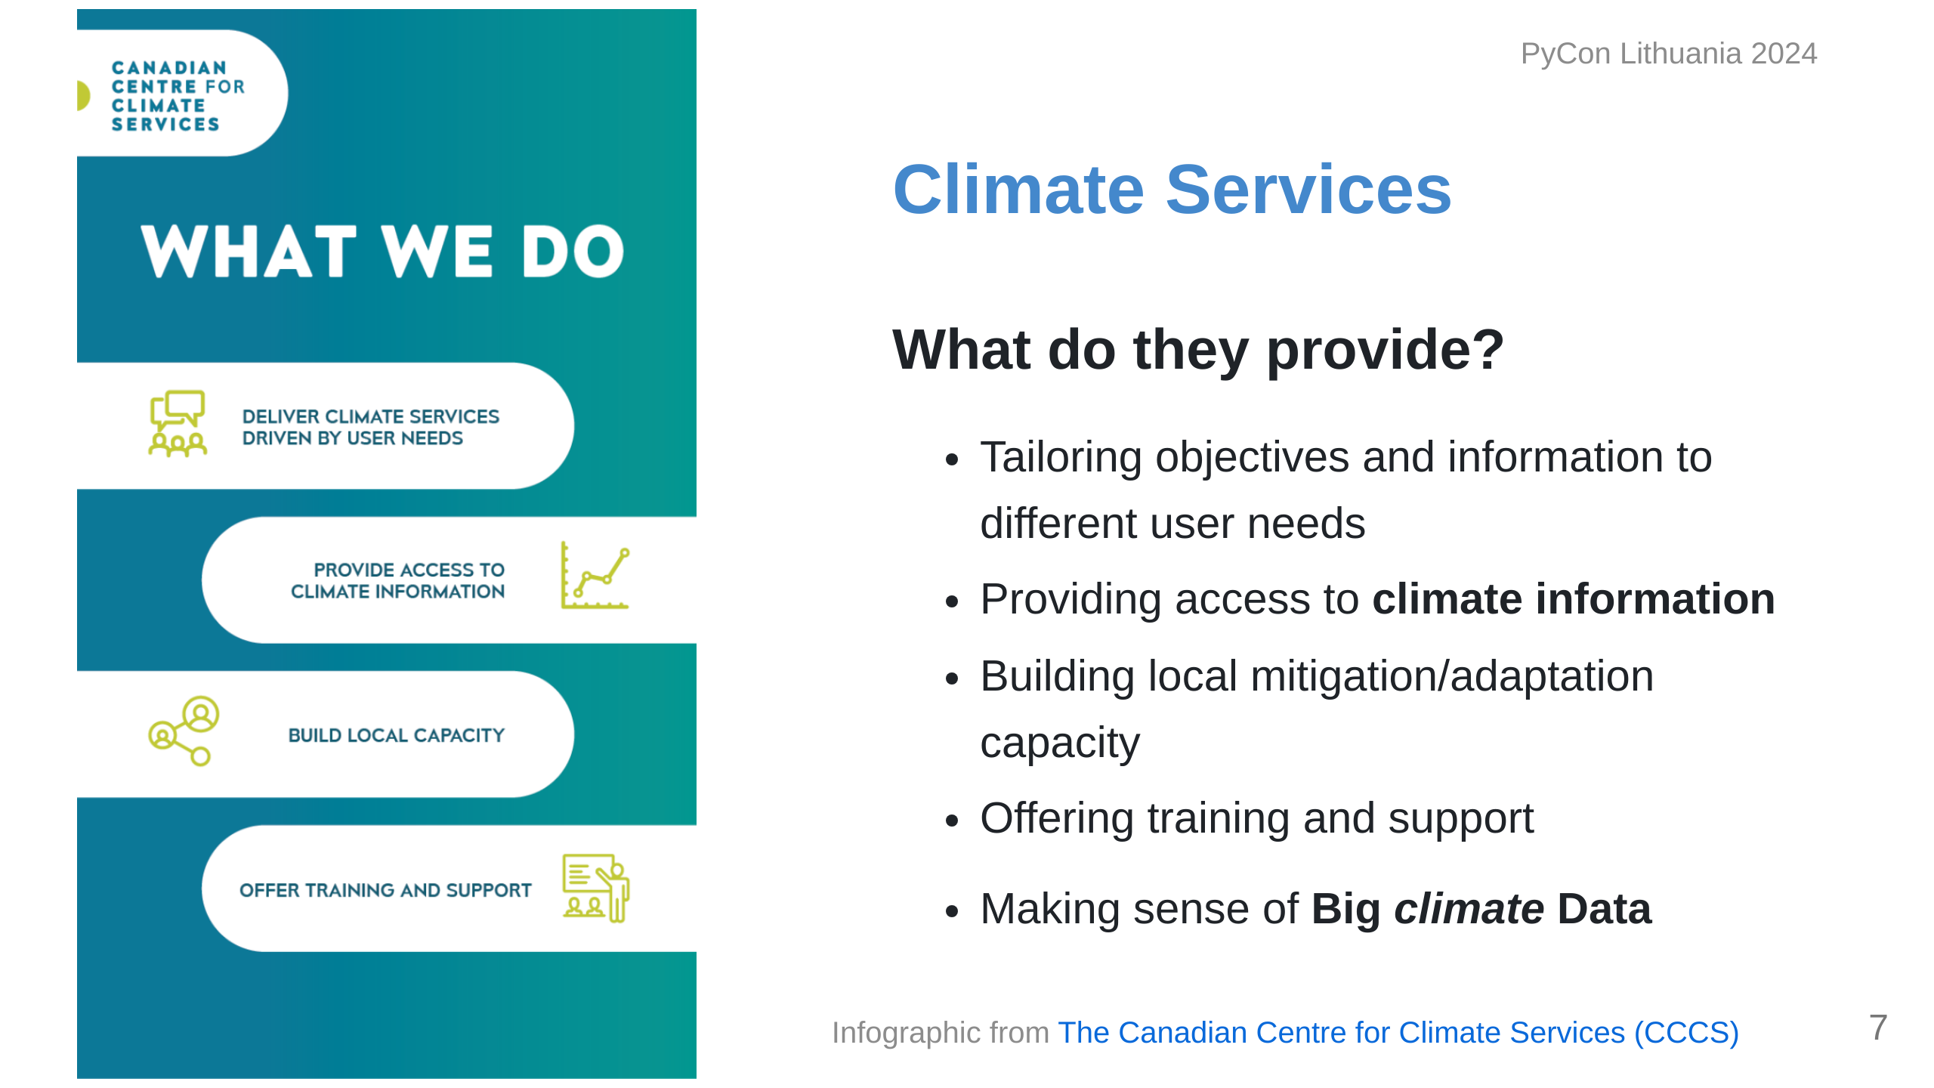
Notes:
Climate Services has been a developing field for a few decades now, more so lately with Climate Change. The idea behind a climate service provider is to act as the bridge between researchers in climate and general audiences. You can imagine being a city planner or someone in an industry that can be impacted by climate conditions; if you don't have a background in climate science, where do you even begin? For this we provide information and training to help **make sense of big climate data**.

Slide 8
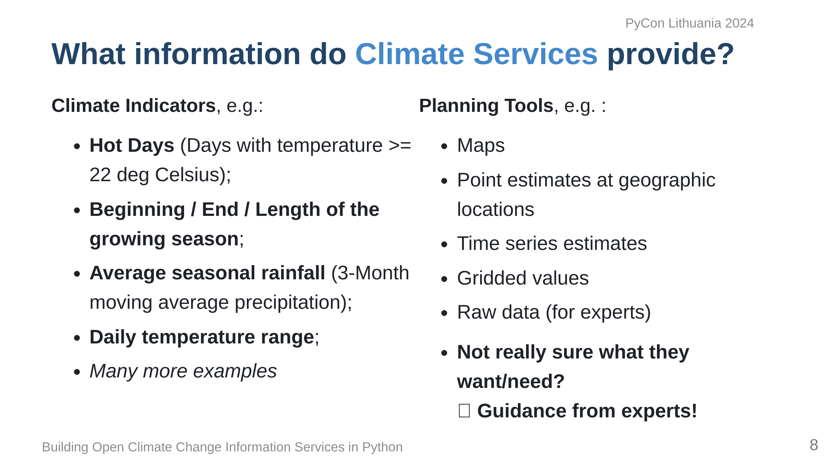
Notes:
So what exactly do we provide? Depending on the context, it could be raw historical data to establish trends, or it could be future projections of climate indicators. My background is more agricultural, so we can imagine wanting to know things that would impact our growing season or placing stressing on the crops. Presenting this information is again dependent on the user; some people like maps, some people want time series, more advanced users might want raw data. In many general cases, they don't know what they want or need, so we help them figure that out!

Slide 9
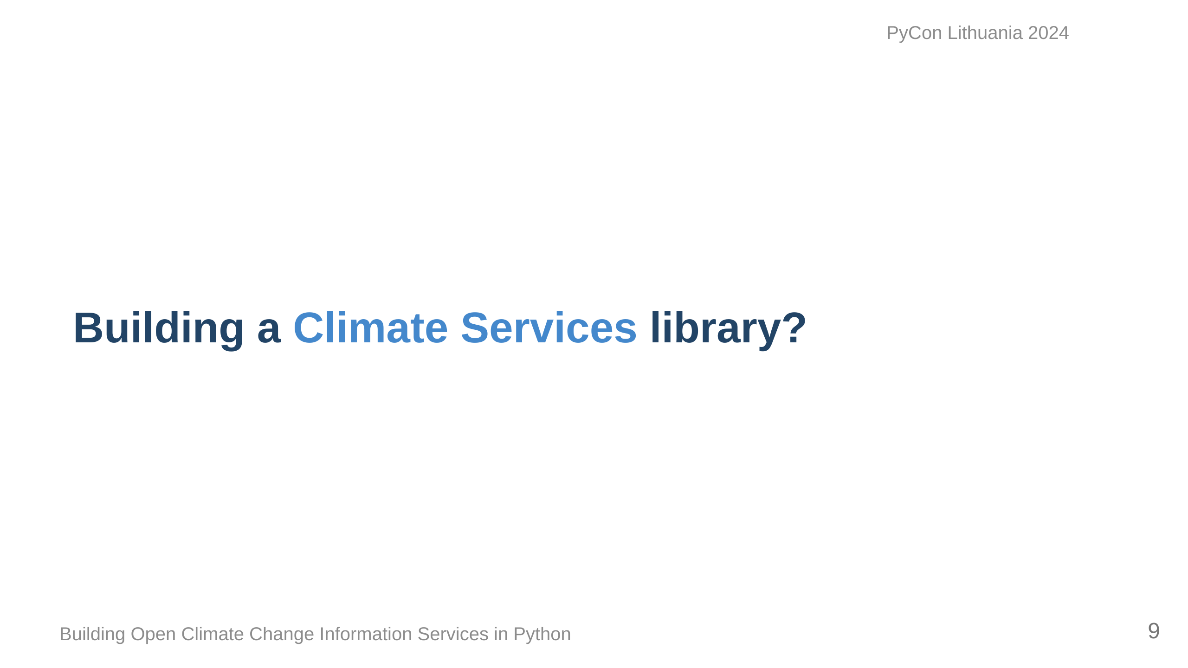
Notes:
Since this field is growing so much and clearly is technically-focused, we should be building tools to better aid us no? So what does it need to do?

Slide 10
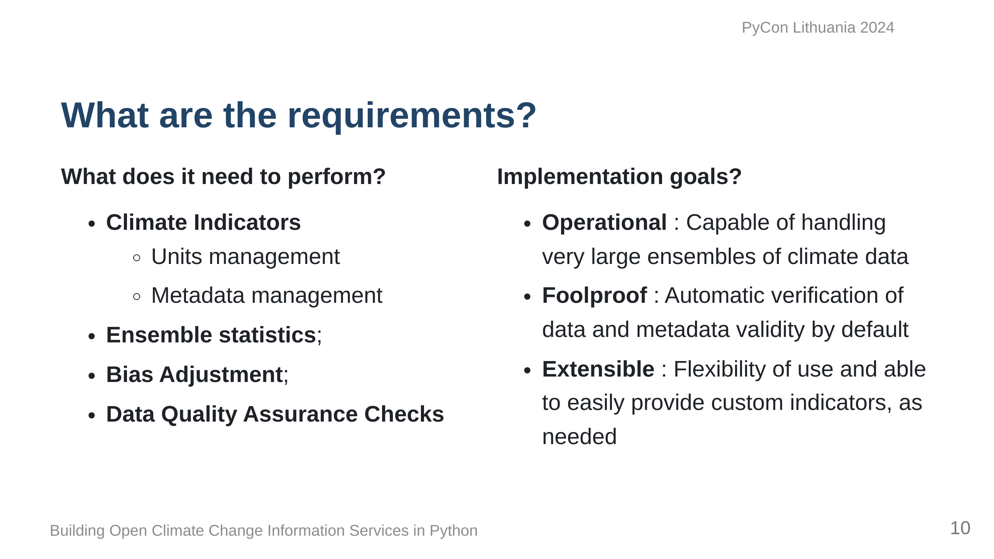
Notes:
At its base, it needs to be able to calculate climate indicators, obviously, and what comes out should be easily used by users or other tools. Often climate data is averaged across models, so ensemble statistics tools are important, as well as ways of correcting bias from models and ensuring what we get out is physically possible. Operationally, it needs to handle Terabytes of data from different sources at times. It should be intuitive, and be relatively mistake-proof, and most importantly, we should be able to extend and build upon it, so that people can customize it to their needs.

Slide 11
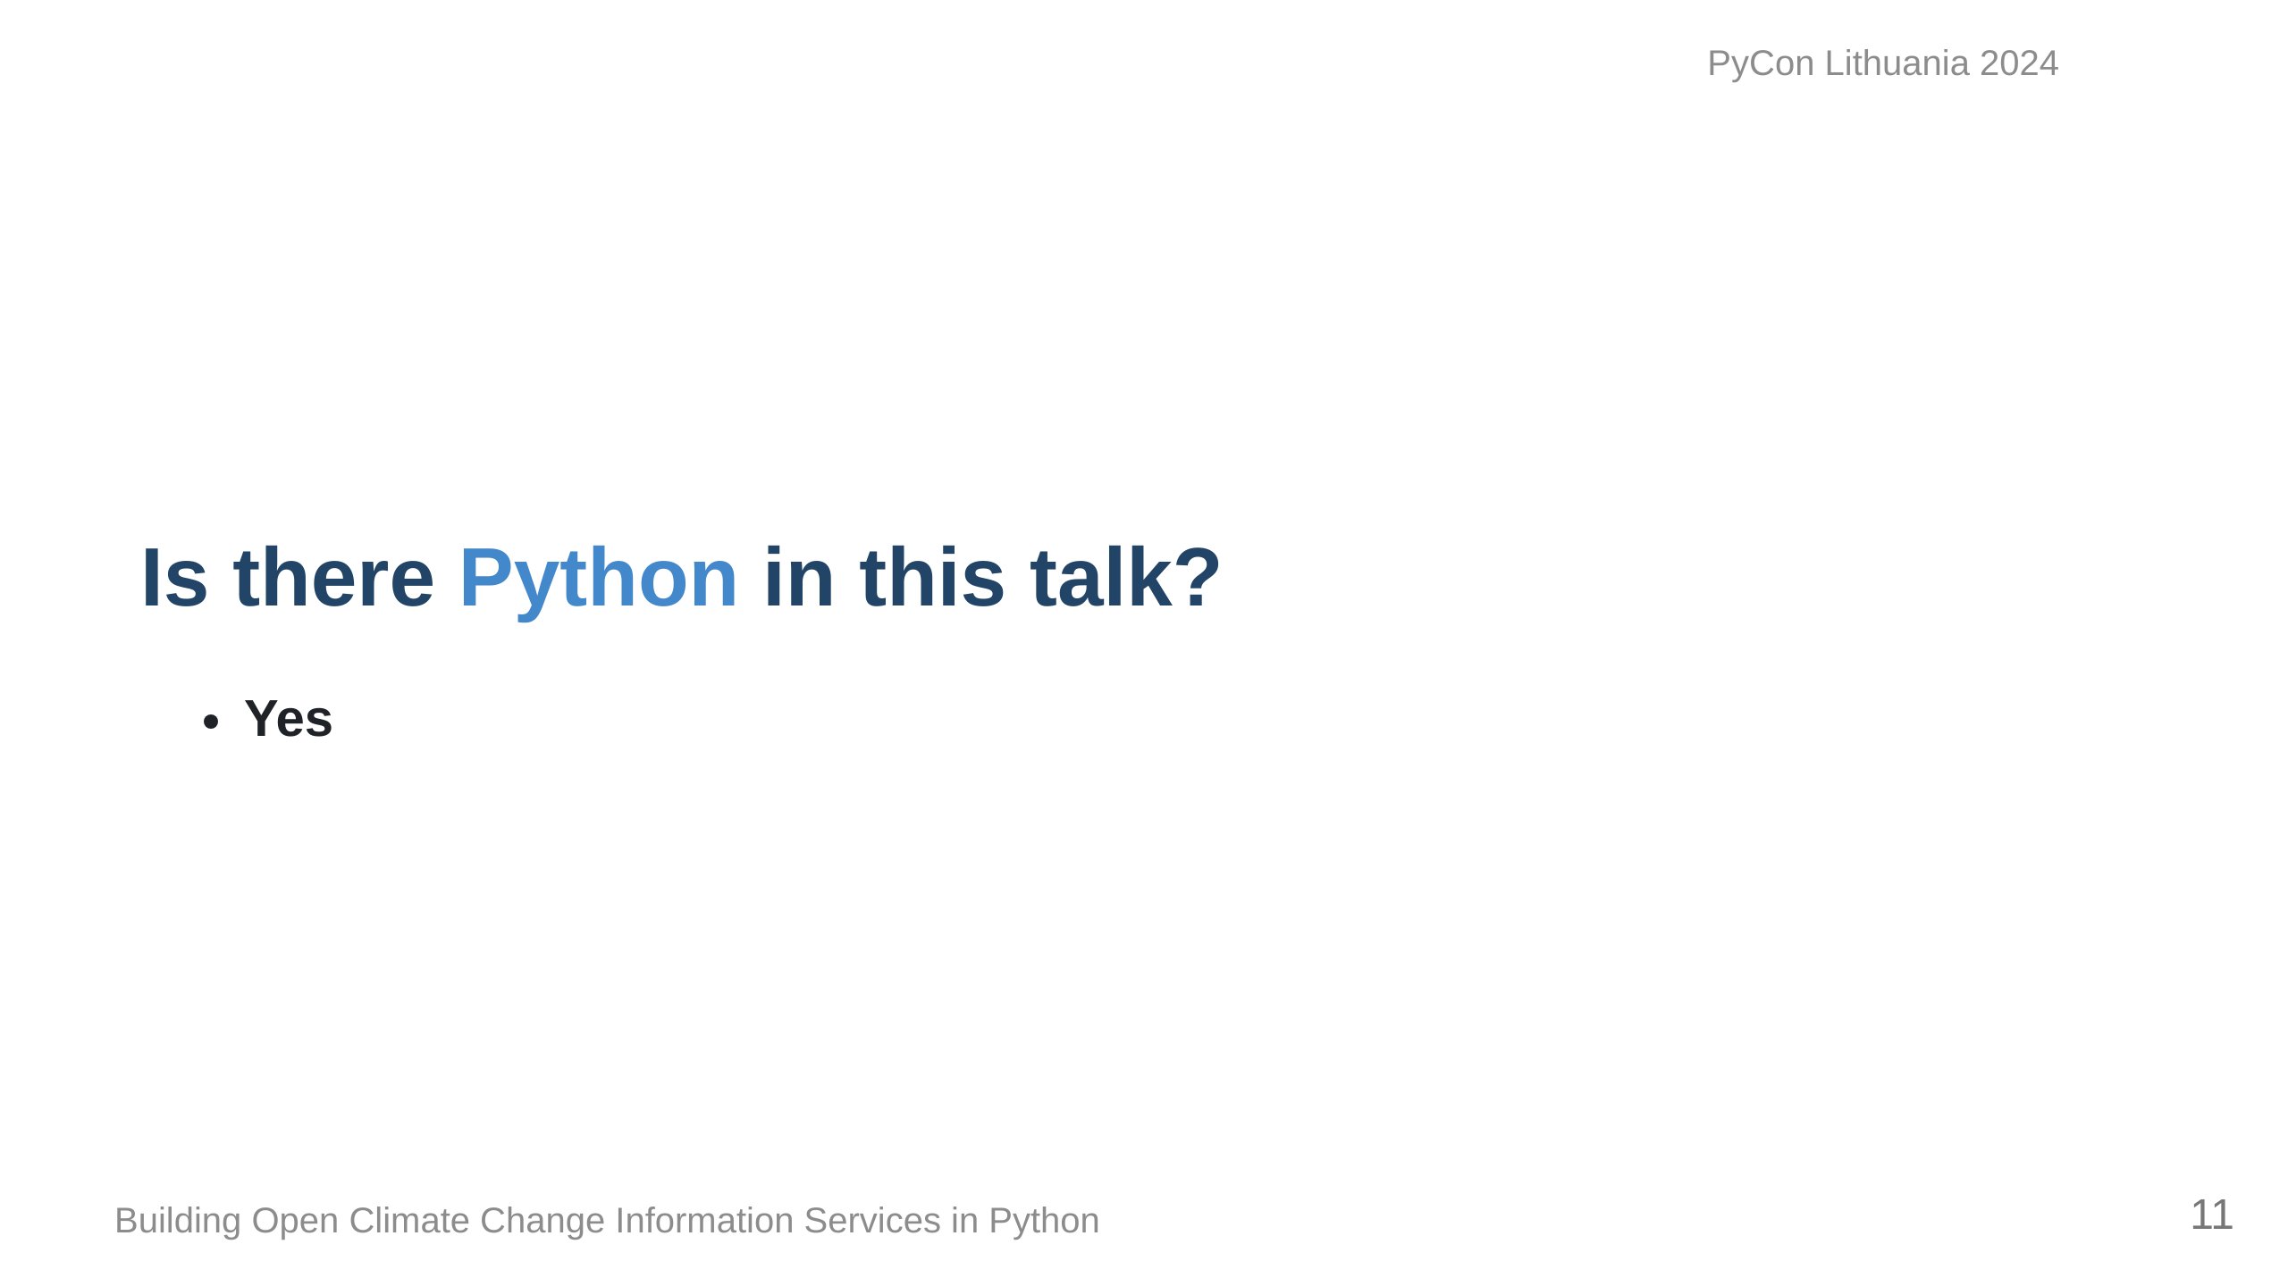
Notes:
At this point, you're probably wondering where Python is coming in, and it's on the next slide.

Slide 12
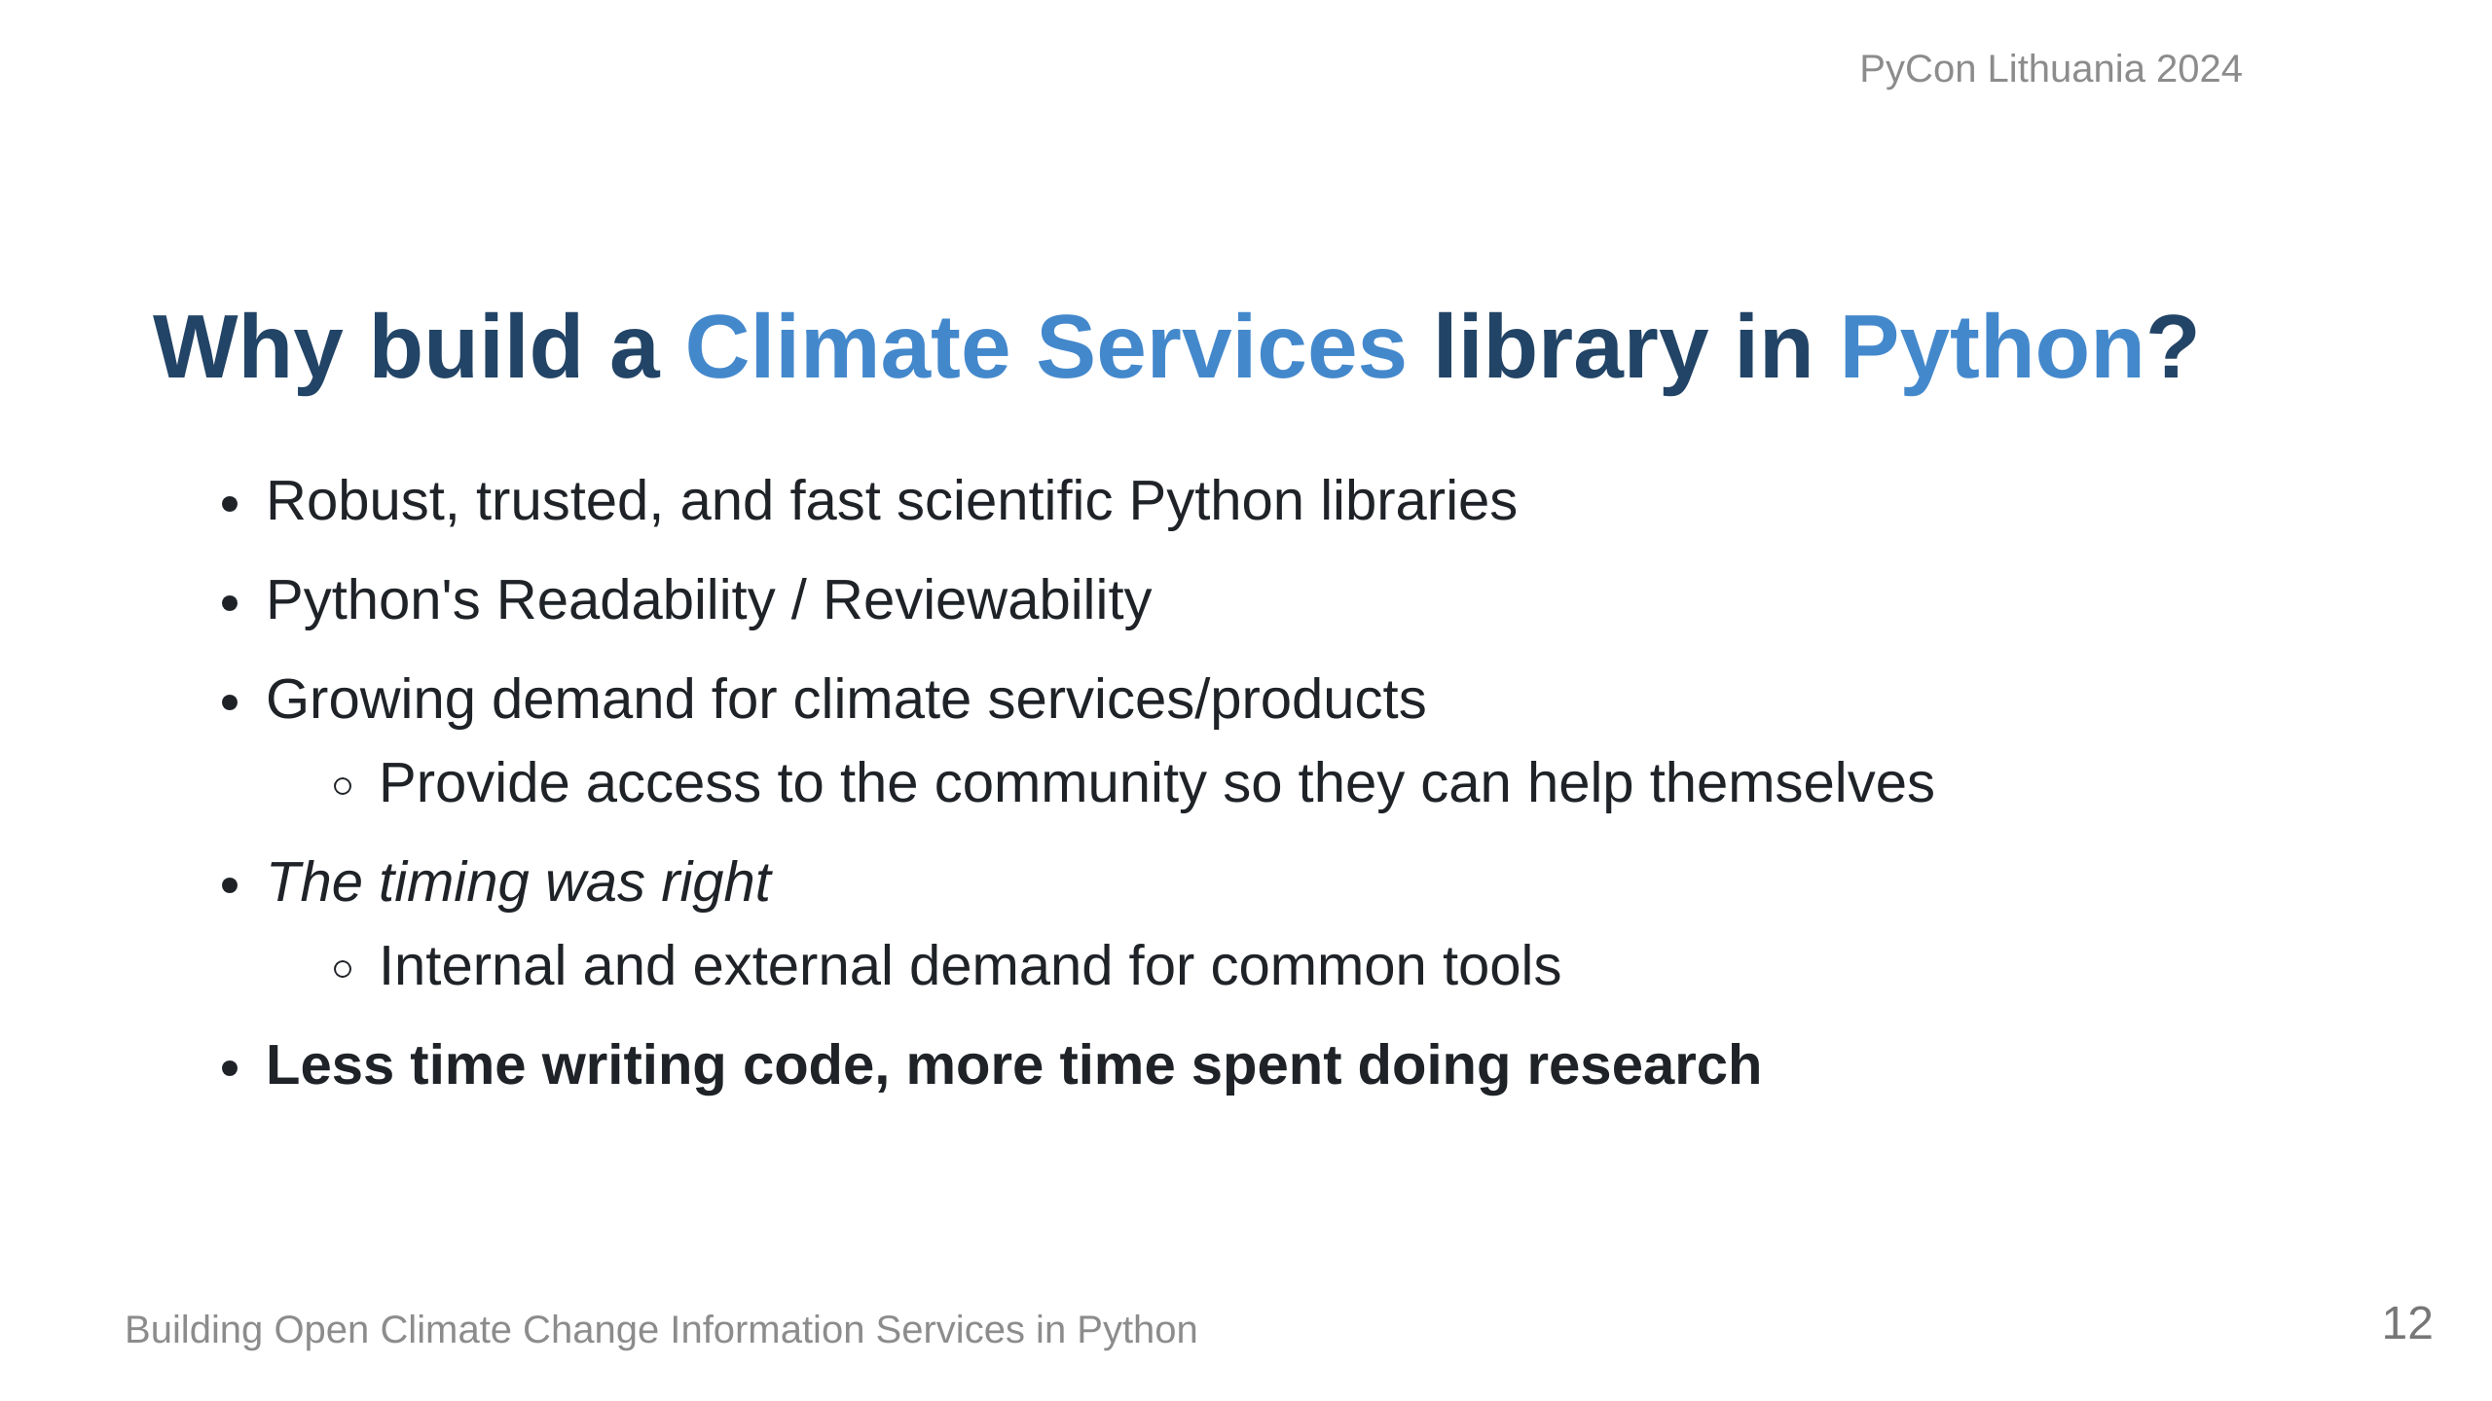
Notes:
We decided to try our hand at building this all in Python for a number of reasons... Our goal ultimately was to ensure that we are ensuring that the research comes first and I think we've done that.

Slide 13
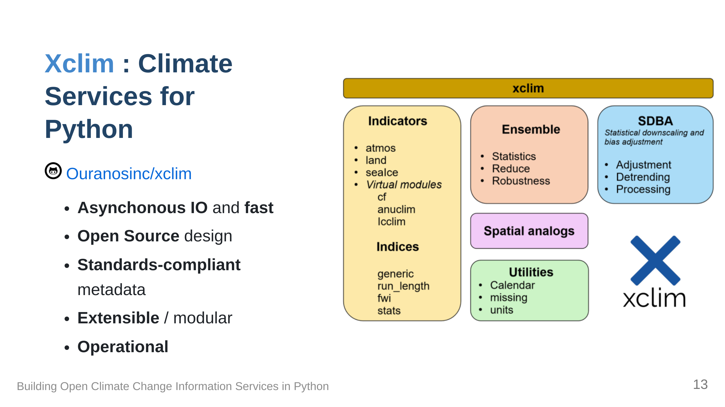
Notes:
Xclim is what we came up with: The library is build with a few key modules, each handling things like indicators, statistics, bias correction and some other utilities. It manages to strike a nice balance between usability and extensibility, and most importantly, it's fast.

Slide 14
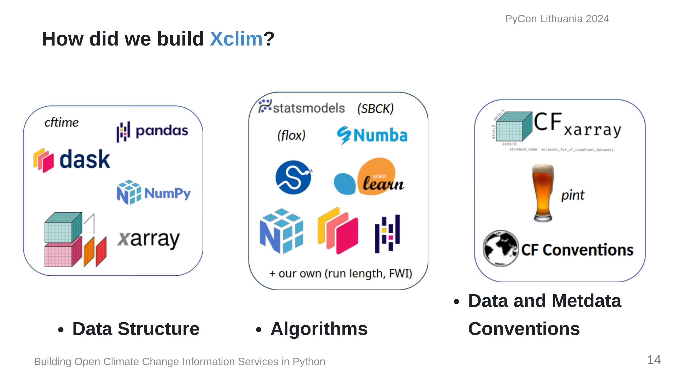
Notes:
We based our data structures on several Open Source scientific Python libraries, namely, Pandas, Numpy and Xarray, ensuring that our code can benefit from the parallelization made possible by Dask. For projects based on xarray, it's customary to put an 'x' in the name, hence 'xclim'. Xclim was built to be an operational library and as such, we built our algorithms based on more conventional libraries such as scipy for statistics, scikit-learn for bias-adjustment. Numba provides Just-in-time compilation and pandas provides the base API for array and time operations. Units management and conventions are also key to ensuring that the outputs of operations can be easily used in other applications, and issues such as unit management are handled via libraries dedicated to ensuring that dimensions are always preserved and expected output units are always the same, regardless of inputs.

Slide 15
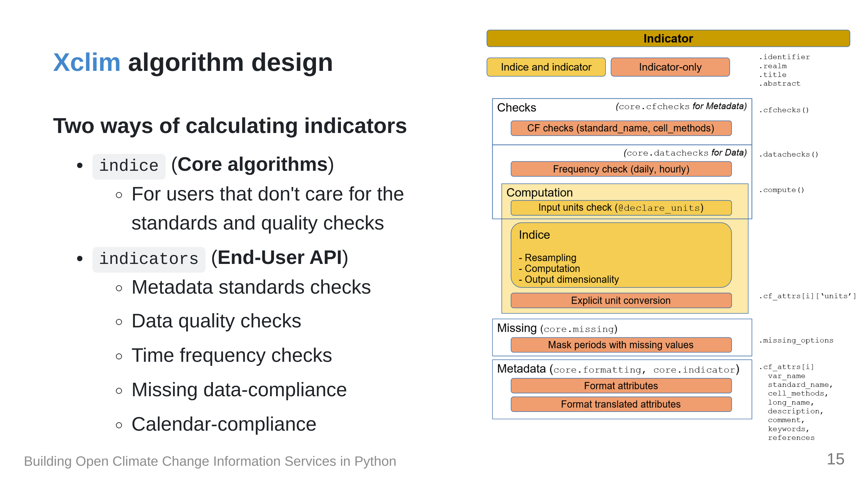

Slide 16
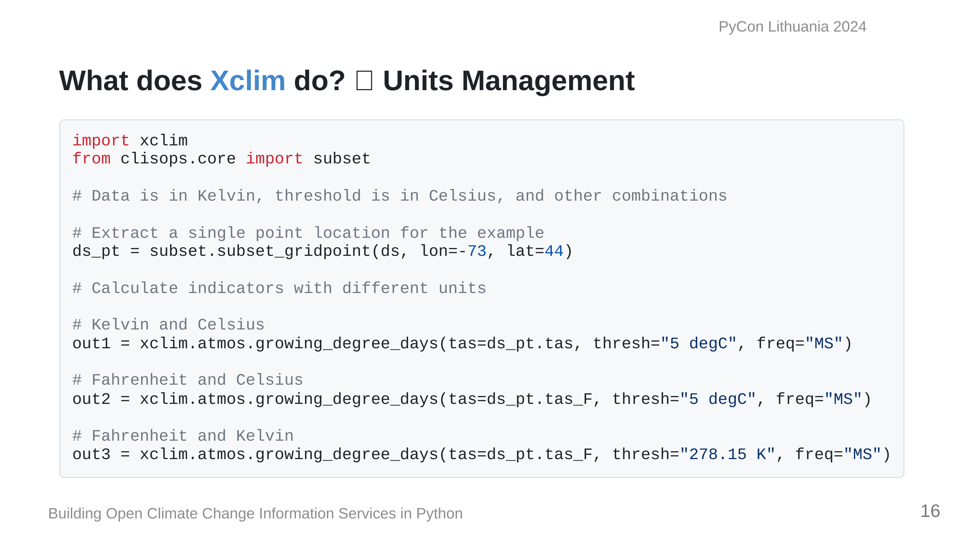

Slide 17
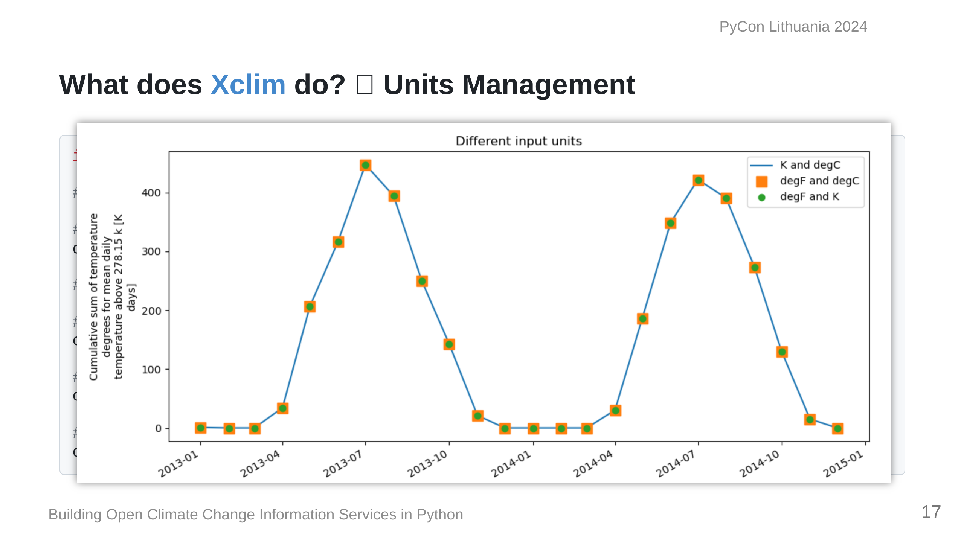

Slide 18
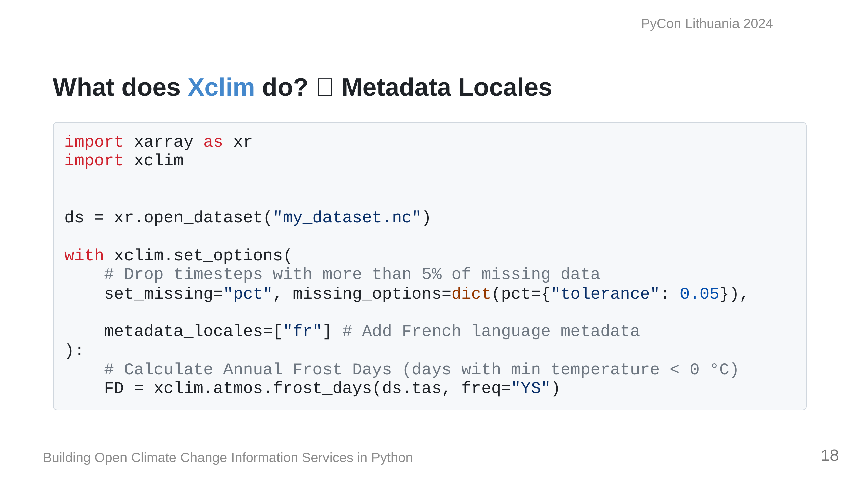
Notes:
`xclim` also has the ability to

Slide 19
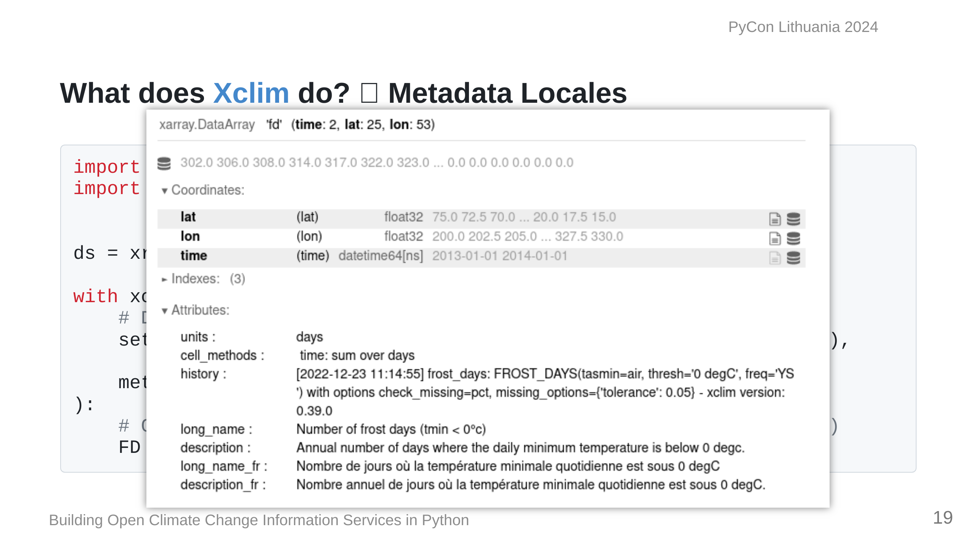

Slide 20
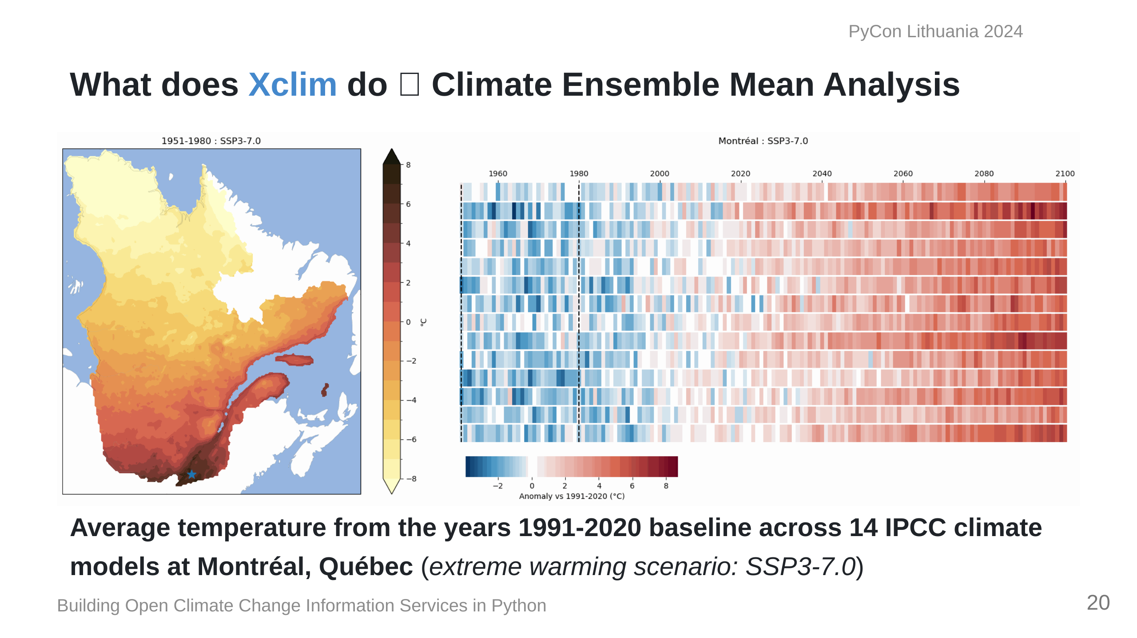
Notes:
This is an example of what we can calculate with `Xclim`; Here we have data from 14 climate models. On the left is the average annual temperature for the province of Quebec, while on the right is the average change from a 1990-2020 baseline across the 14 models.

Slide 21
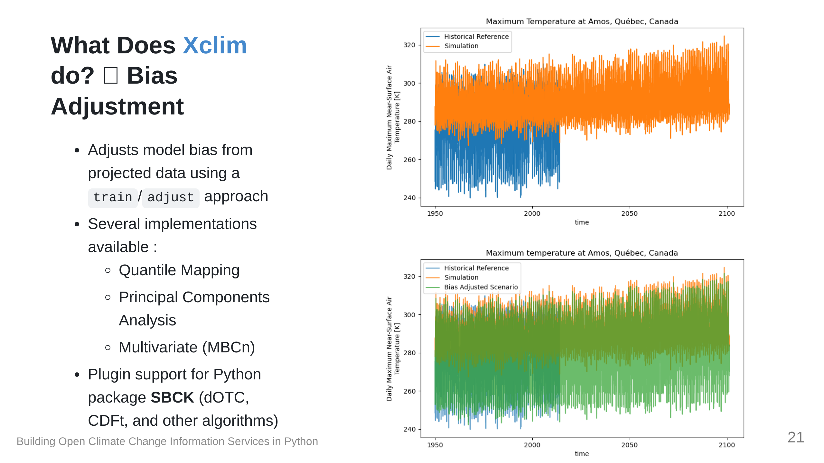

Slide 22
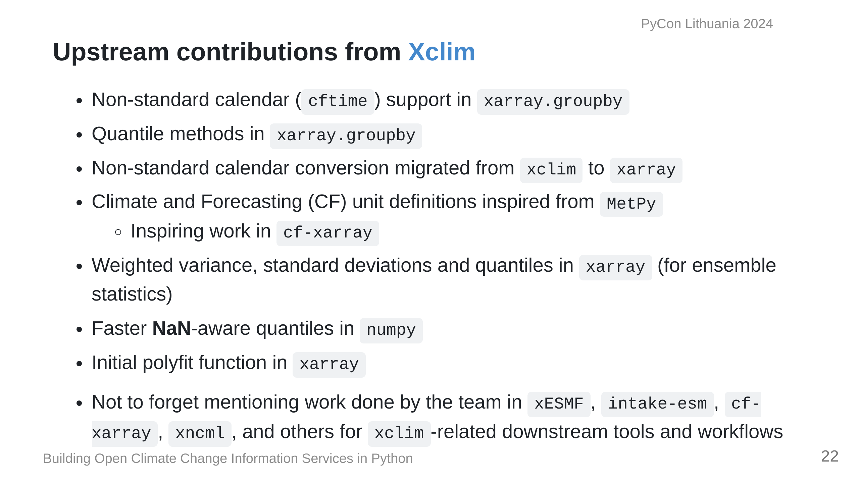
Notes:
Building this tool has also involved a lot of upstream contributions as well, addressing bugs or adding features to better

Slide 23
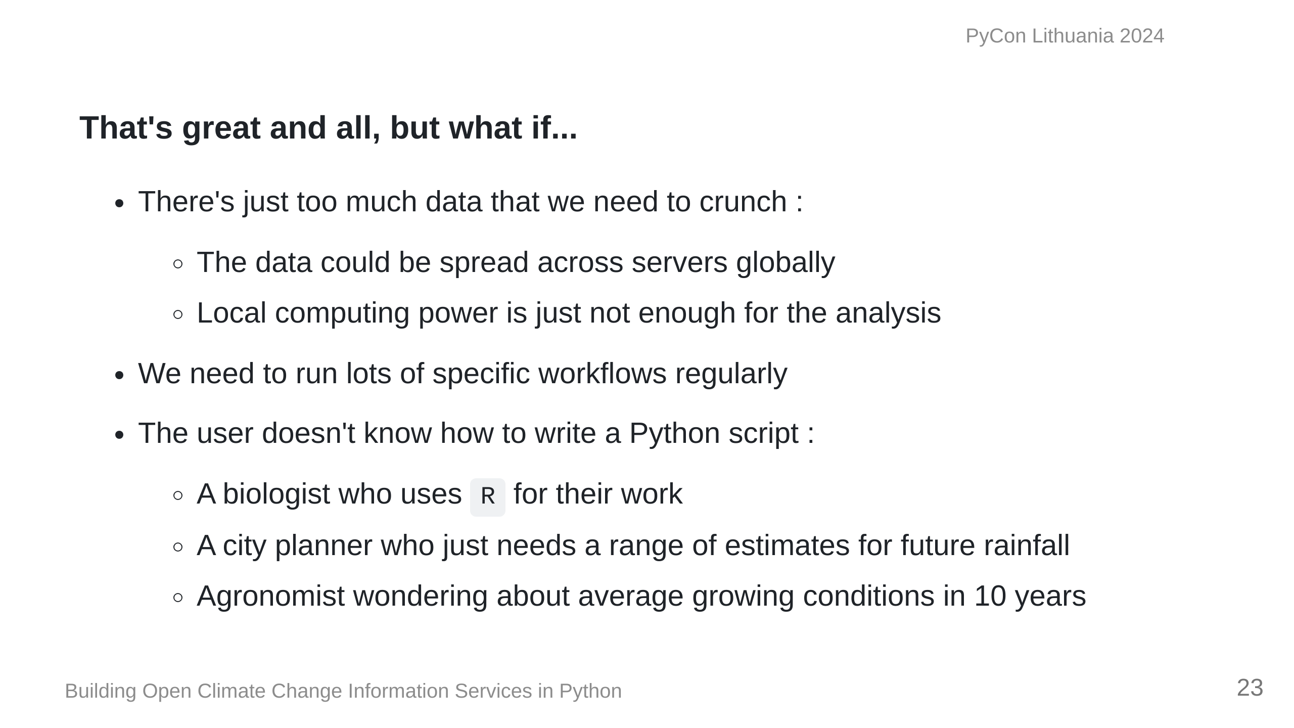

Slide 24
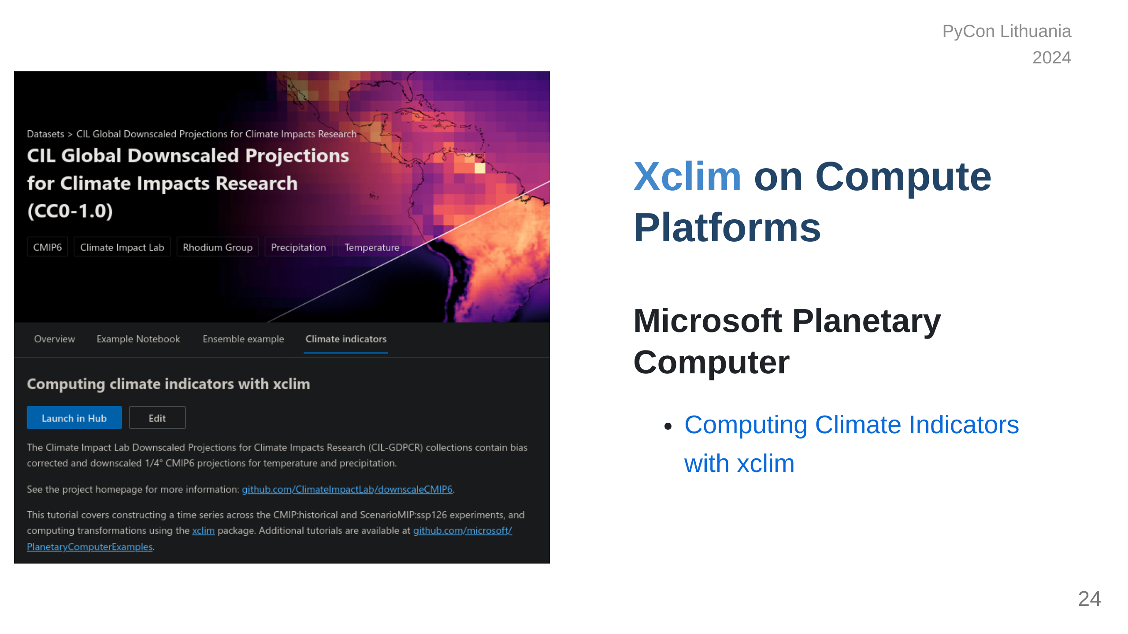

Slide 25
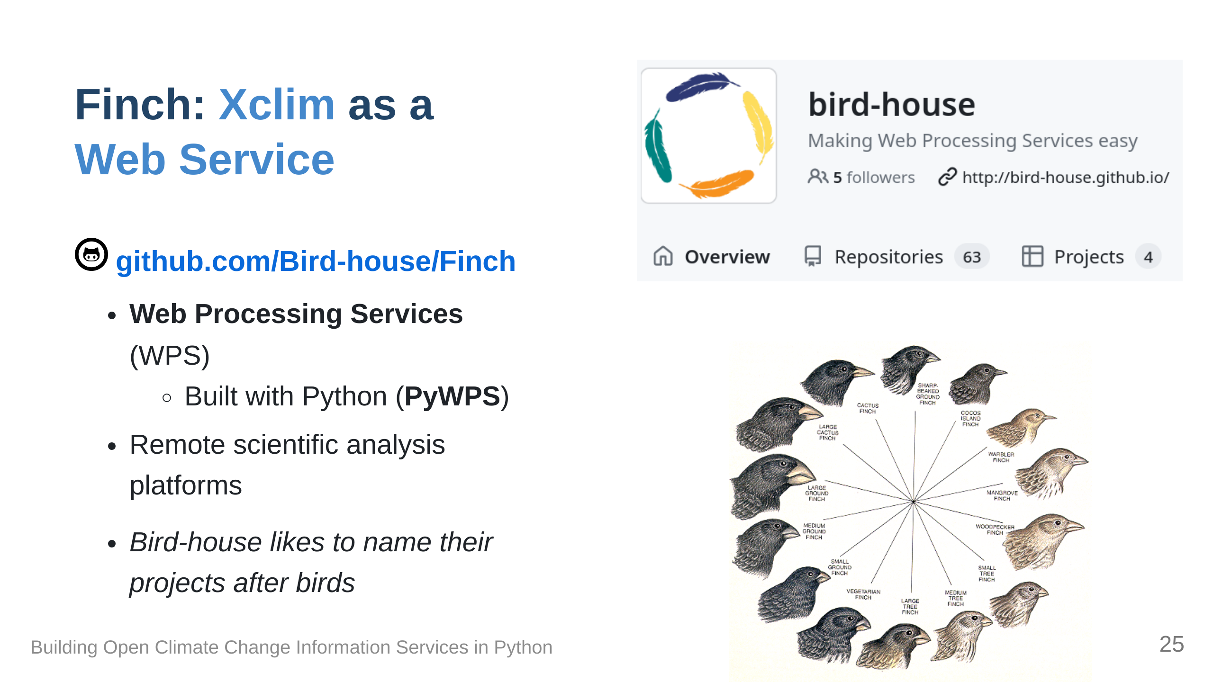

Slide 26
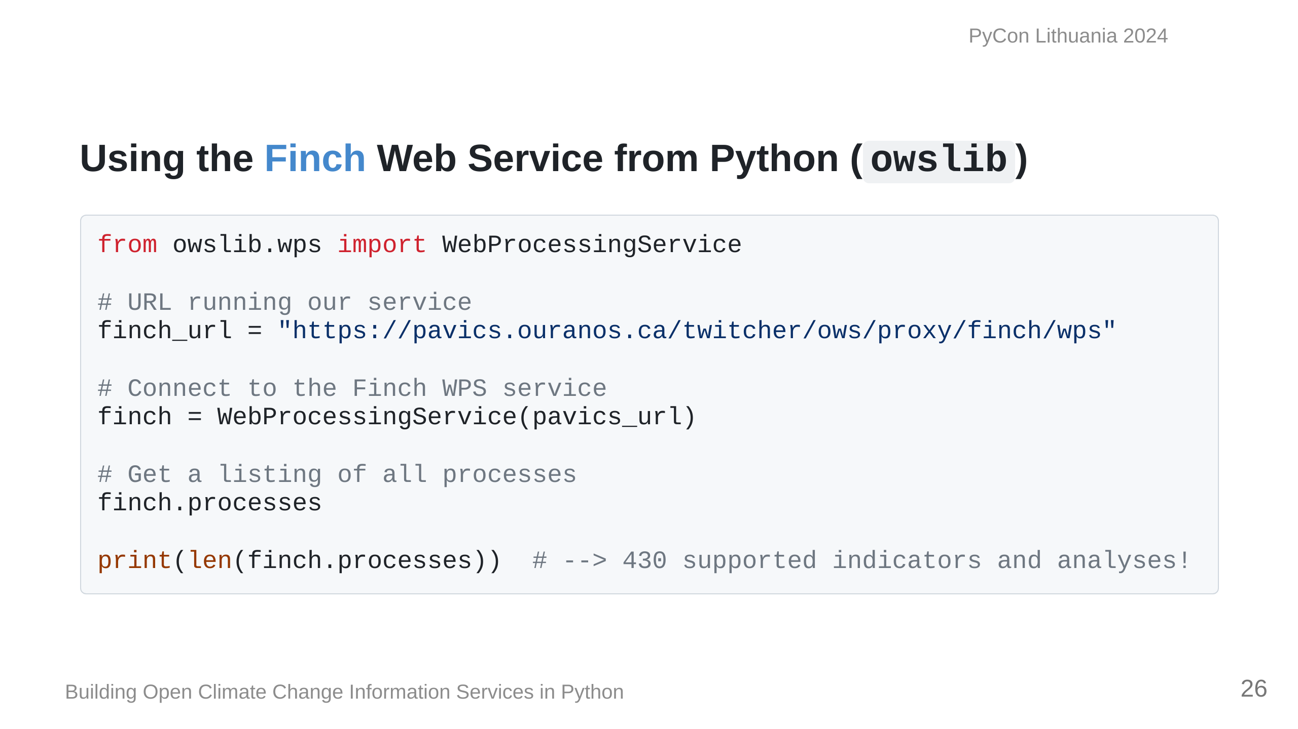

Slide 27
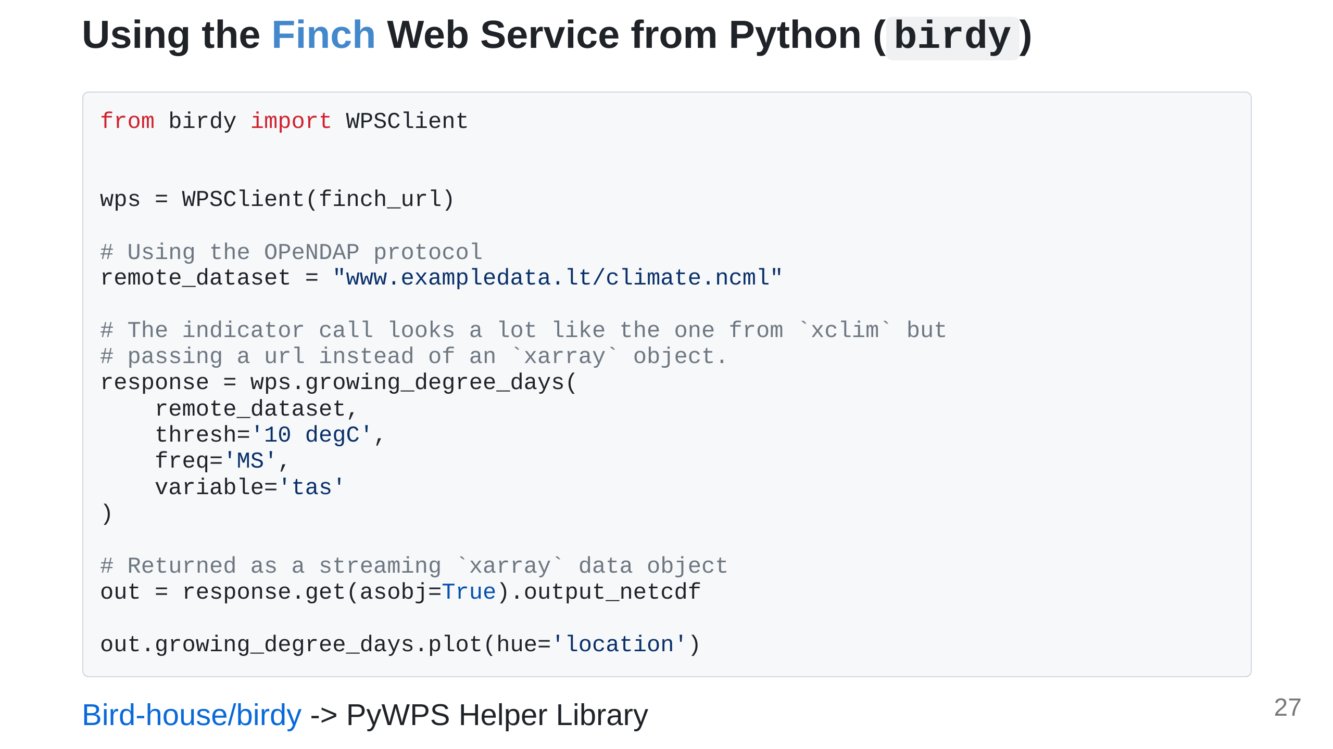

Slide 28
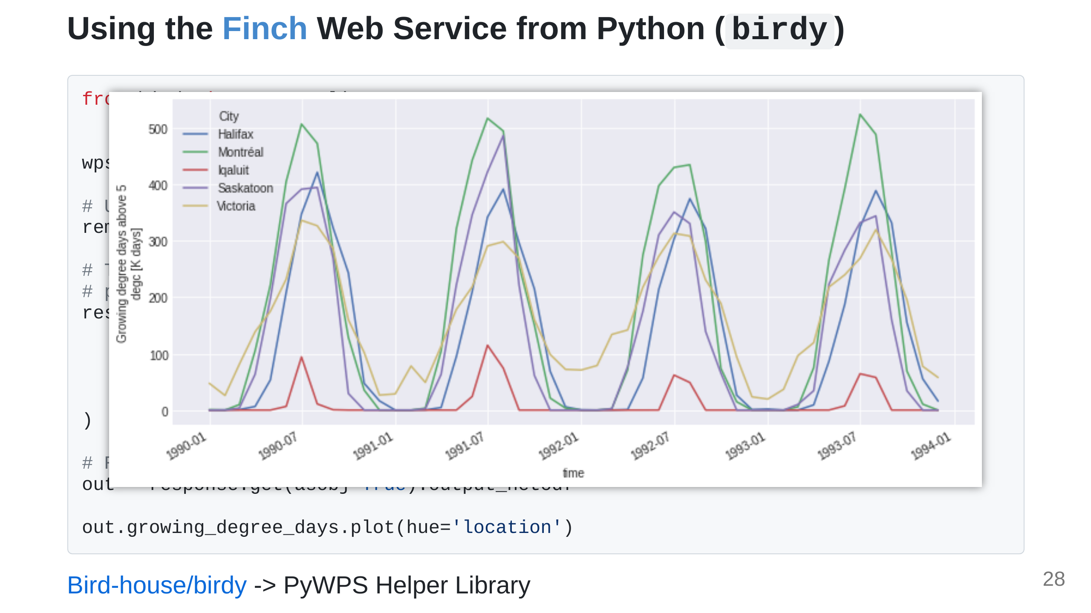

Slide 29
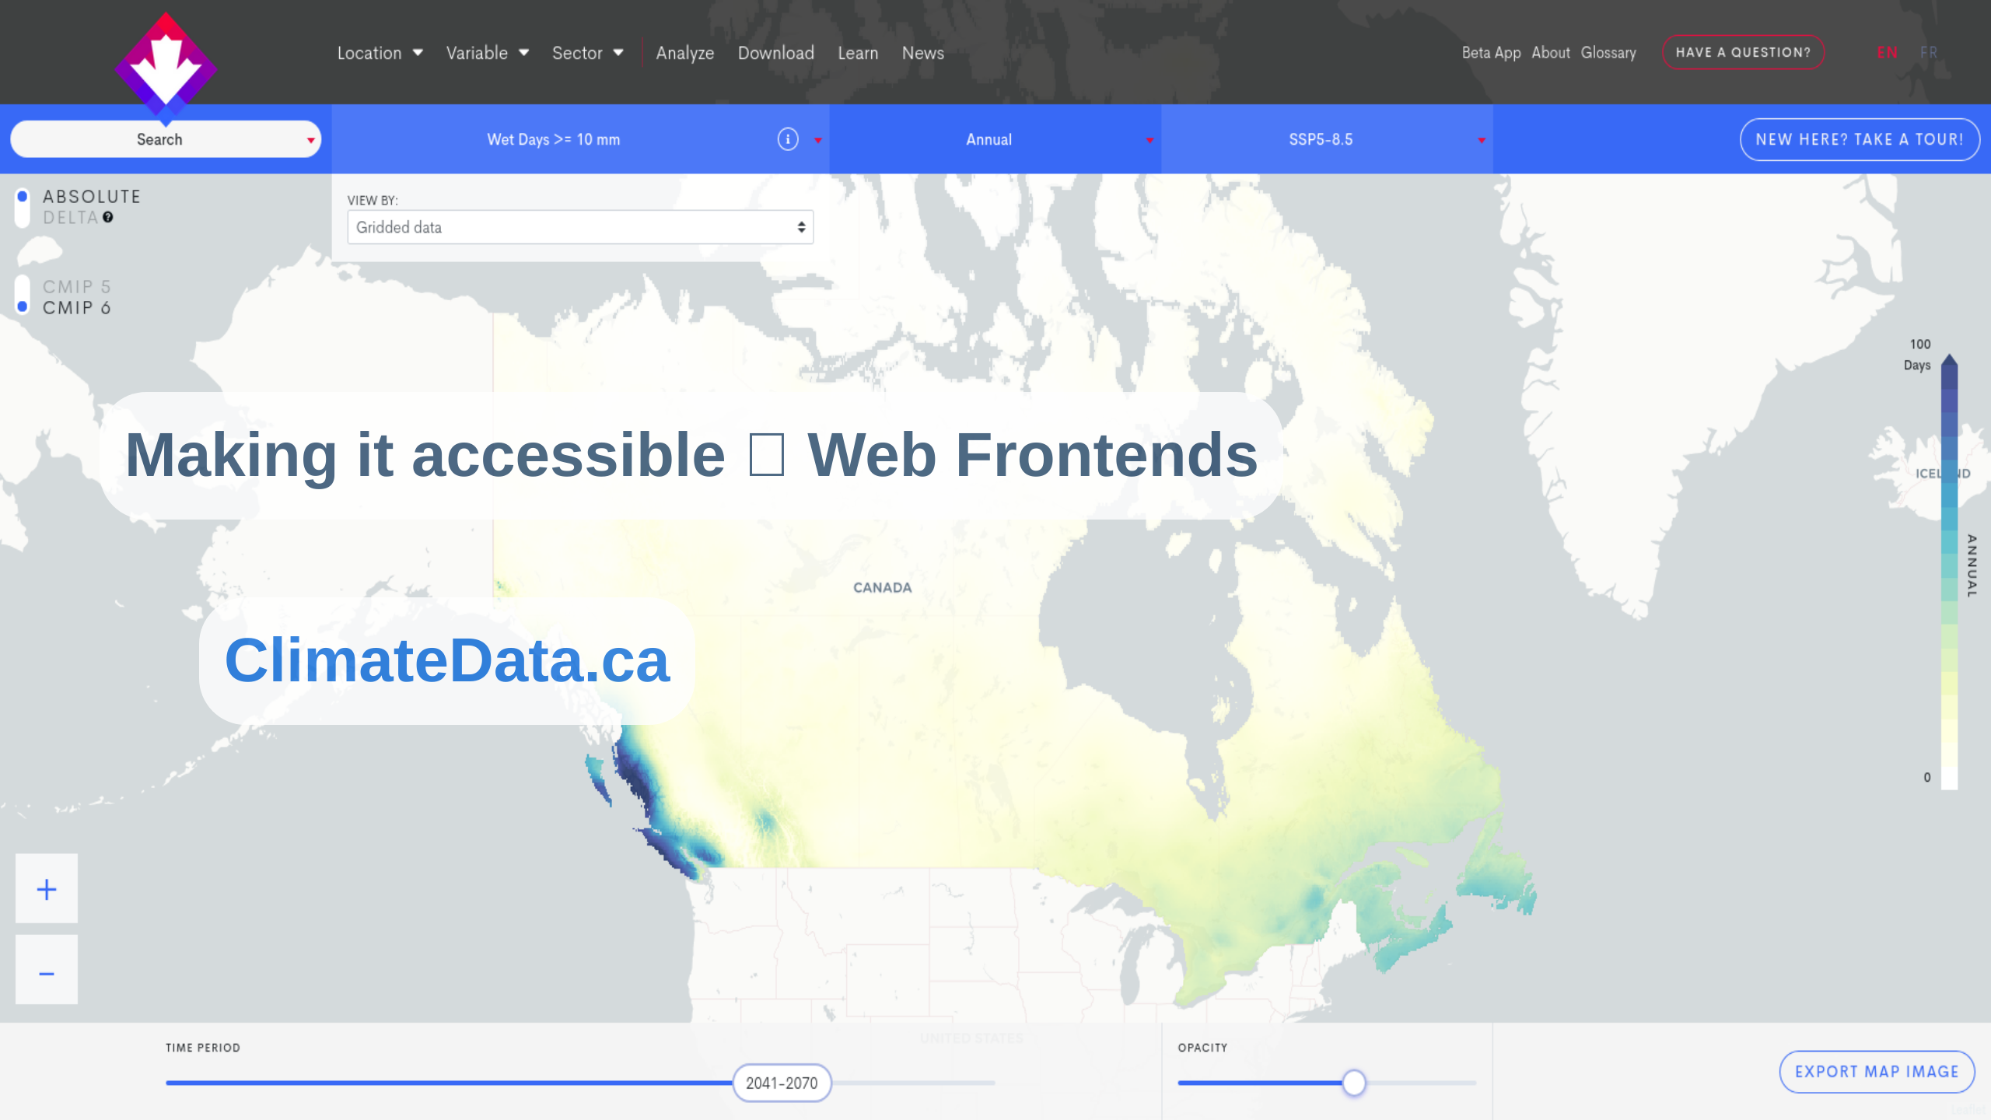

Slide 30
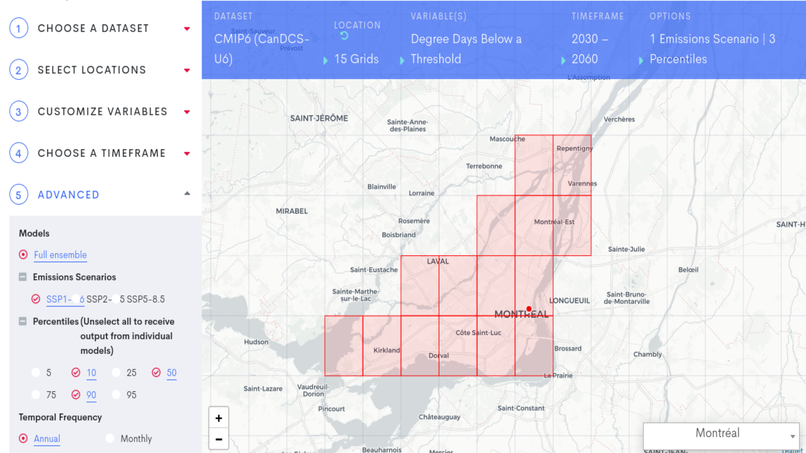

Slide 31
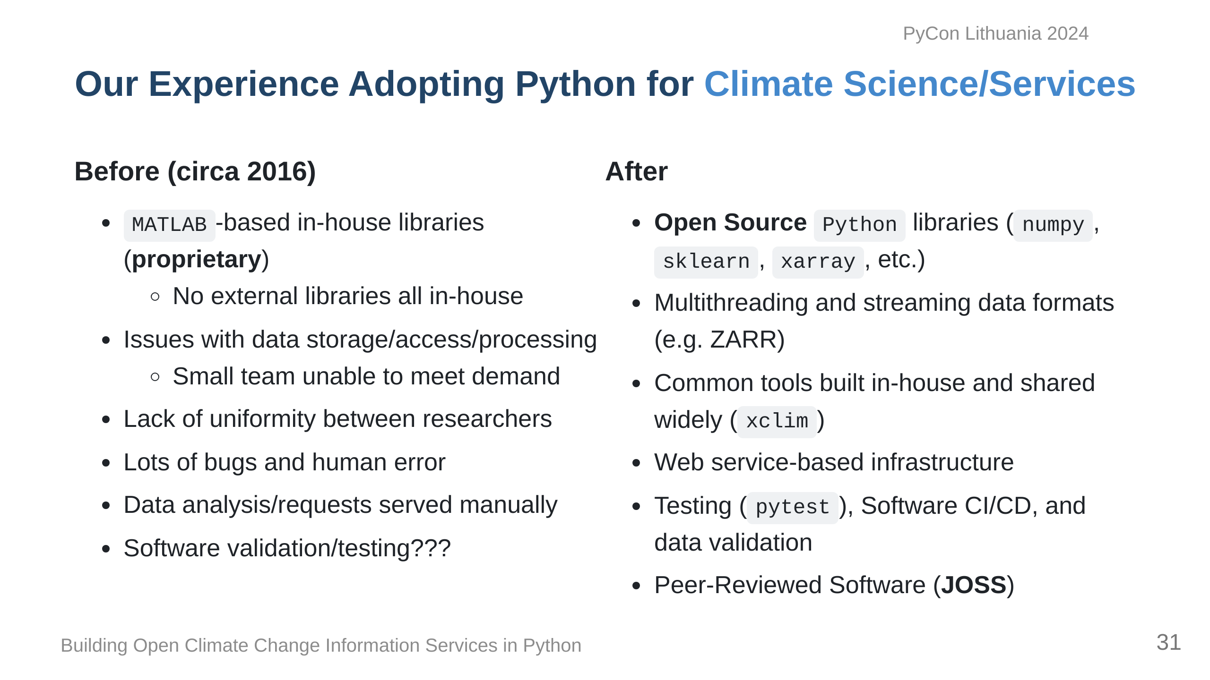

Slide 32
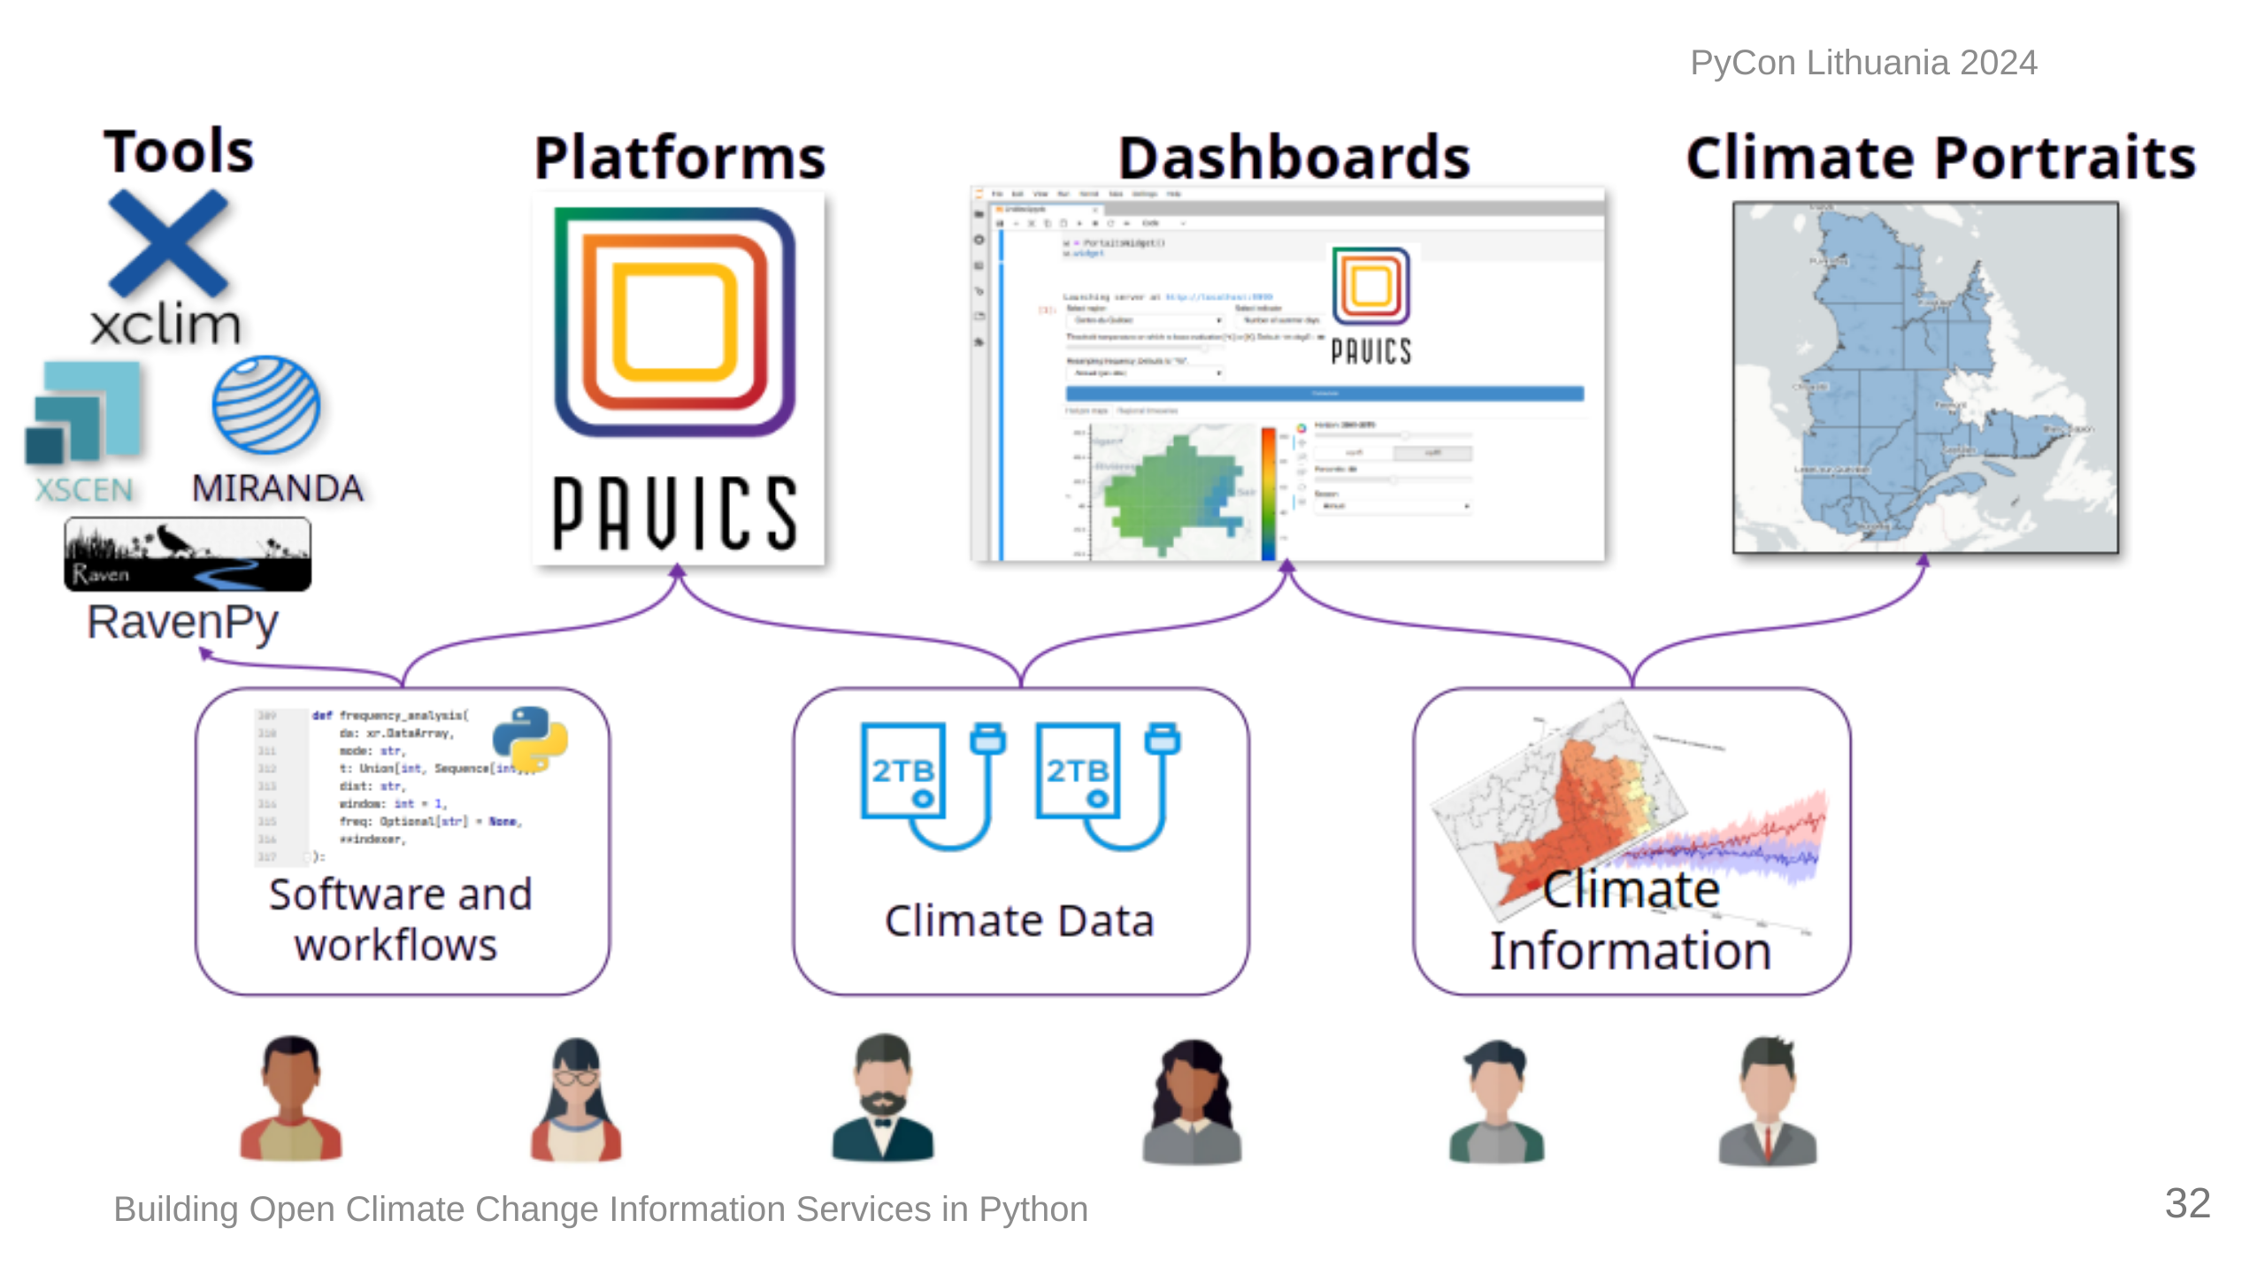

Slide 33
